Slide 1
Project R
Team 13

Slide 2
Table of Contents
Abstract
Problem Statement
Project Deliverables
Project Scope
Resources
Expertise
Team
Project Timeline

Slide 3
Condensed Abstract
Main theme: side-scroller roguelike digital game on Windows
Features
Permanent death
Equippable weapons and armors - dropped by enemies
Progressively stronger enemies
Equipment augmentations
Environmental challenges such as traps and puzzles
Challenges
Relatively short time
Learning Unity

Slide 4
Problem Statement
Inspired by classic roguelike games, our team wanted to create a roguelike game with our own flavor.
We hope to have as many people as possible to enjoy our game
Our goal is to experience what it is like to develop a video game and learn how to use Unity engine.

Slide 5
Project Deliverables
The final product will include:
Main menu
Moveable Character
Combat System
Drop System
Currency
Pause Menu
Playability with keyboard

Slide 6
Project Scope
Planning Phase
Goals
Mechanics
Stories
Gameplay Development
Physics
Combat System
Main Menu & Pause Menu
Item Drop System
Currency
Aesthetic Designing
Level & Character Design
Story Implementation

Slide 7


Resources
Computers suitable to run Unity.
We will use Unity Teams to develop simultaneously as a group
Piskel - Online sprite editor

Slide 8
Expertise
Primary:
Game Development Skills
Leadership
Stenography
Secondary:
Graphic Design
Music Design
Storytelling

Slide 9
Team Members and Roles
Min Dye
Scott Hargrove
Ryan Do
Peter Wainwright
Vice-Project Director
Lead Designer
Developer
Scribe
Project Director
Application Developer

Slide 10
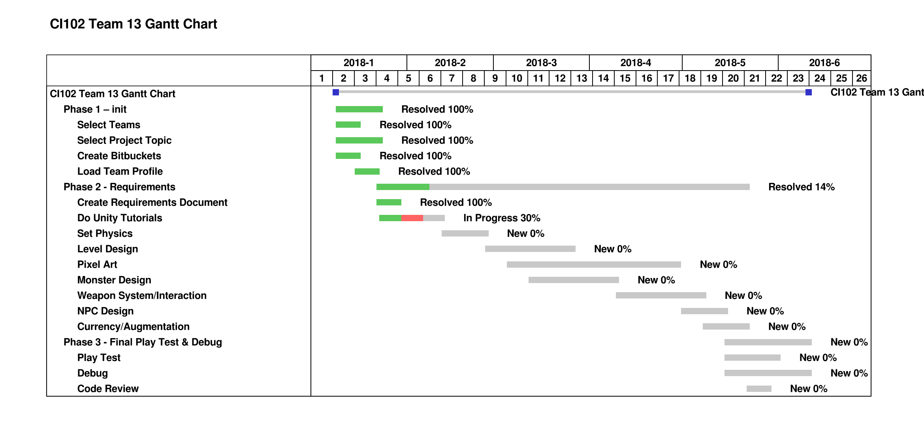
Project timeline

Slide 11
Q&A

Slide 12

Thank you!
Min Dye
Scott Hargrove
Ryan Do
Peter Wainwright

